Slide 1

Bhagwan Mahavir College Of Computer Application
Subject : Seminar
Topic : Wireless Network
Presentnted by :
Sujal Bharatbhai Mavani
(2102020101508)
Guided by :
Asst.Prof.Kruti Patel

Slide 2
Table Of Content
About My Self
Defination
Type
Use
Refrence

Slide 3
About My Self
Hello everyone, I’m Mavani Sujal Bharatbhai.
Currently, I'm enrolled in the 6th semester of BCA at BMCCA.
My enrollment number is 2102020101508.
I'm delighted to participate in today's seminar.
Throughout my academic journey, I've developed a keen interest in Web Development.
Thank you for giving me this great opportunity for study in BMCCA for BCA.

Slide 4
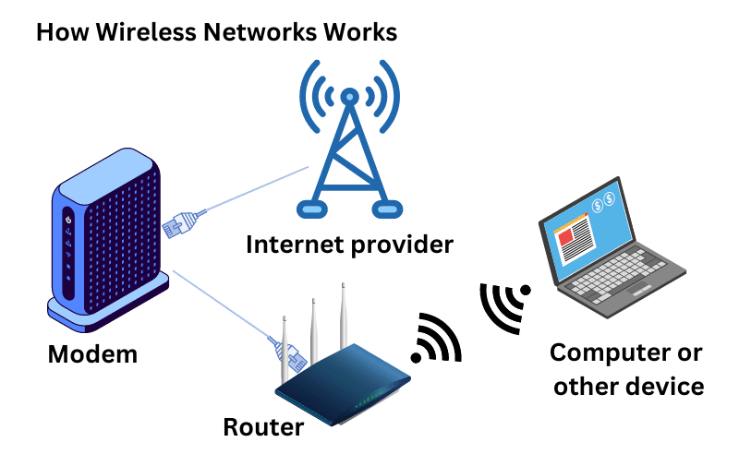
Wireless Network

Slide 5
Definition
A wireless network is a telecommunications network that utilizes radio waves or infrared signals instead of physical wires or cables to transmit data between devices. It allows multiple devices, such as computers, smartphones, tablets, and other electronic devices, to communicate with each other and access the internet or other network resources without the need for direct wired connections

Slide 6
Definition
Wireless access points, also known as base stations or wireless routers, serve as central hubs in a wireless network. They receive data from wireless devices and transmit it to other devices within the network or to the internet. Access points are typically connected to a wired network infrastructure, such as Ethernet or fiber optic cables, to facilitate communication with devices outside the wireless network

Slide 7
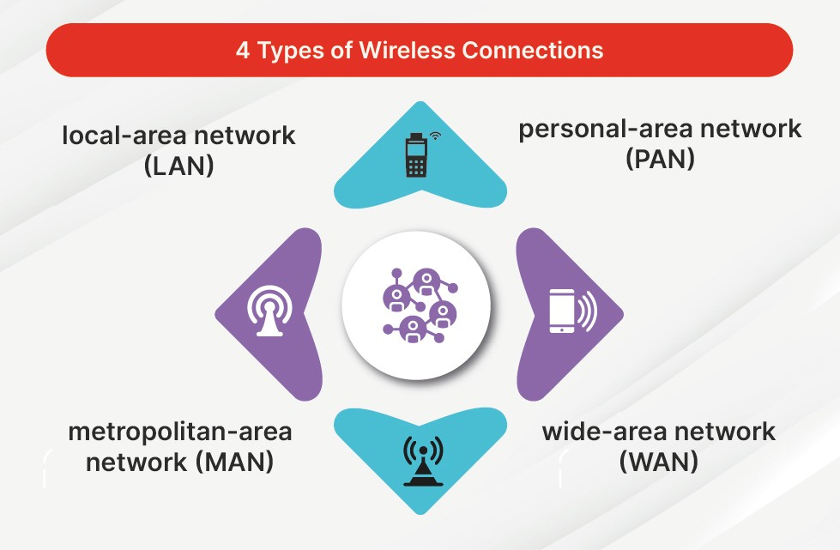
Type

Slide 8
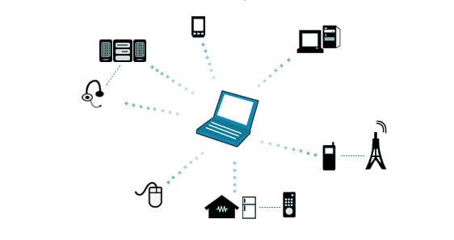
Wireless Personal Area Network(WPAN)
Definition: A WPAN is a short-range wireless network that typically spans an area of a few meters or less, often used for communication between devices in close proximity to each other.
Examples: Bluetooth and Zigbee are common technologies used in WPANs.

Slide 9
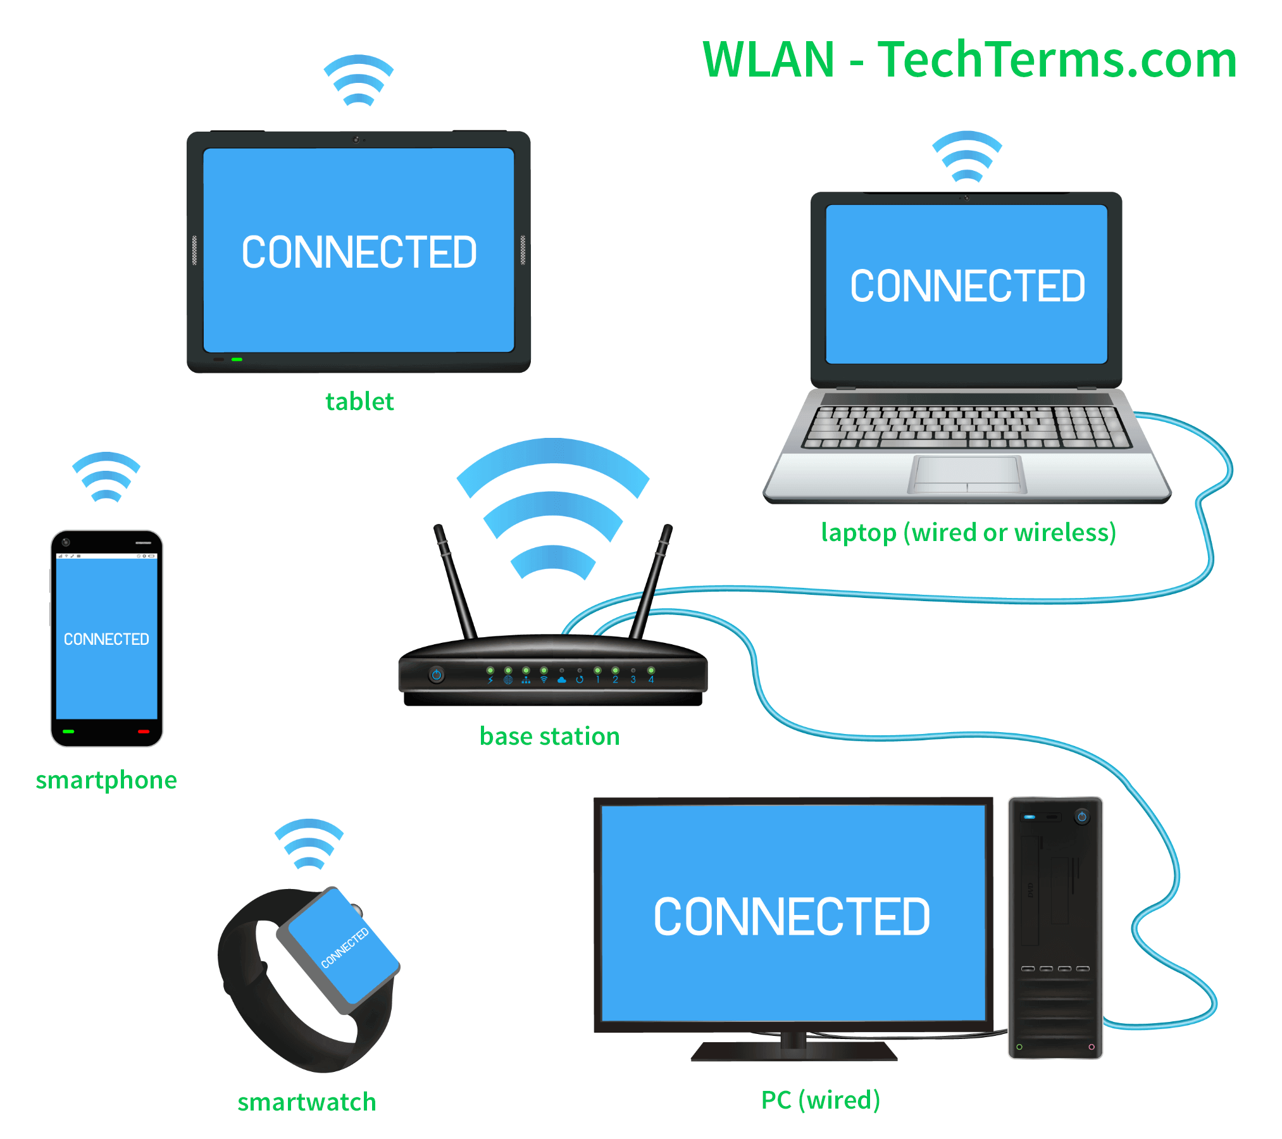
Wireless Local Area Network (WLAN)
Definition: A WLAN is a wireless network that covers a local area such as a home, office, or campus.
Examples: Wi-Fi is the most commonly used technology for WLANs.

Slide 10
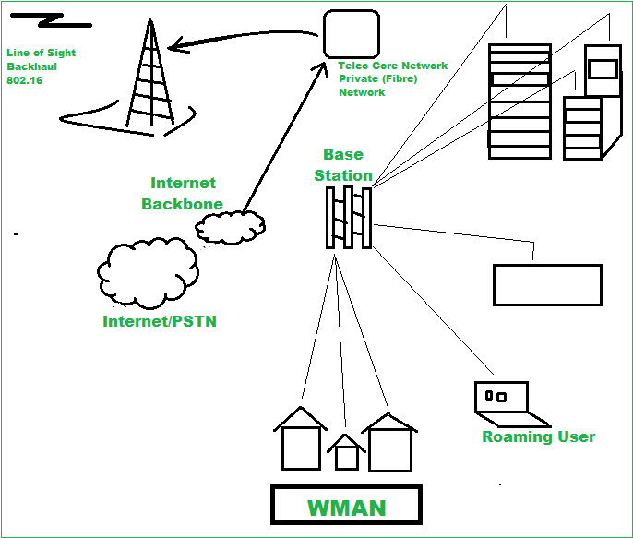
Wireless Metropolitan Area Network (WMAN)
Definition: A WMAN is a wireless network that covers a larger geographical area
than a WLAN, typically spanning a city or town.
Examples: WiMAX (Worldwide Interoperability for Microwave Access) is a common
technology used in WMANs.

Slide 11
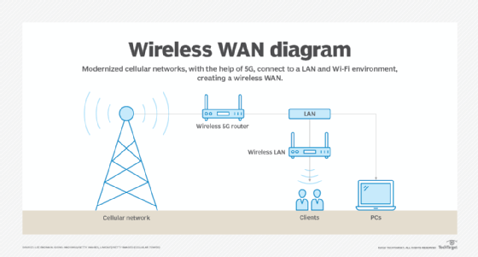
Wireless Wide Area Network (WWAN)
Definition: A WWAN is a wireless network that covers a large geographical area,
such as a country or continent.
Examples: Cellular networks, satellite communications, and technologies like
LTE (Long-Term Evolution) are used in WWANs.

Slide 12
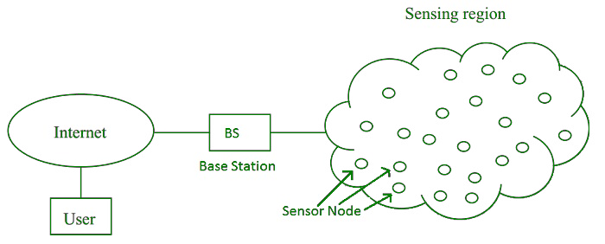
Wireless Sensor Network (WSN)
Definition: A WSN is a network of interconnected sensors that communicate
wirelessly to collect and exchange data from the environment.
Examples: WSNs are used in various applications such as environmental monitoring,
industrial automation, and healthcare.

Slide 13
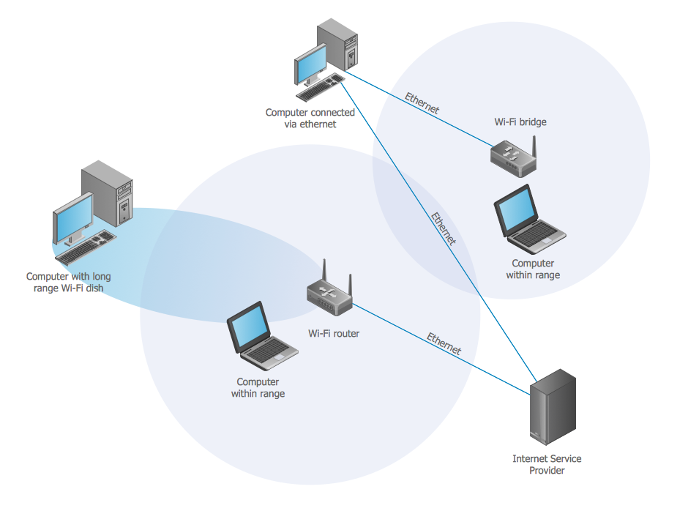
Use

Slide 14
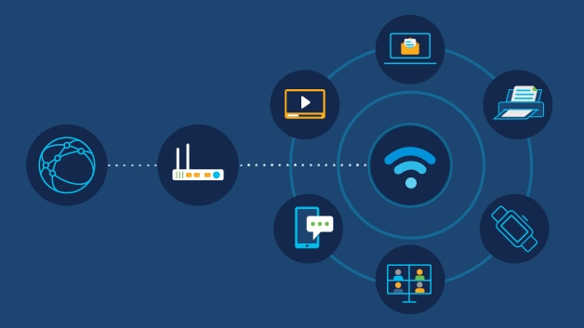
Internet Access
Wireless networks enable ubiquitous internet access, allowing users to connect to the web from virtually anywhere within the coverage area. This facilitates online activities such as browsing, emailing, social networking, and accessing cloud-based services.

Slide 15
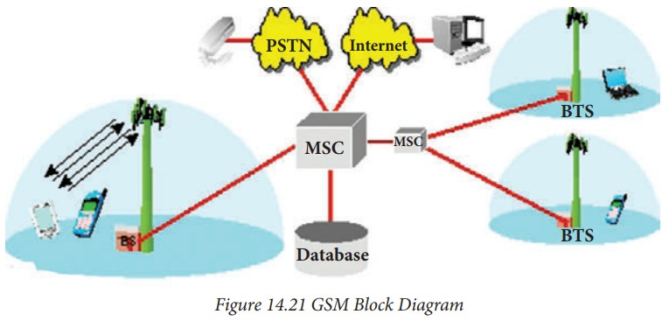
Mobile Communication
Wireless networks power mobile communication technologies, including cellular networks, enabling voice calls, text messaging, and mobile data services. Mobile phones and smartphones rely on wireless networks to stay connected while on the move.

Slide 16

Enterprise Connectivity
In business environments, wireless networks provide connectivity for computers, printers, and other devices without the need for physical cables. This fosters flexibility in office layouts, promotes collaboration, and supports remote work initiatives.

Slide 17
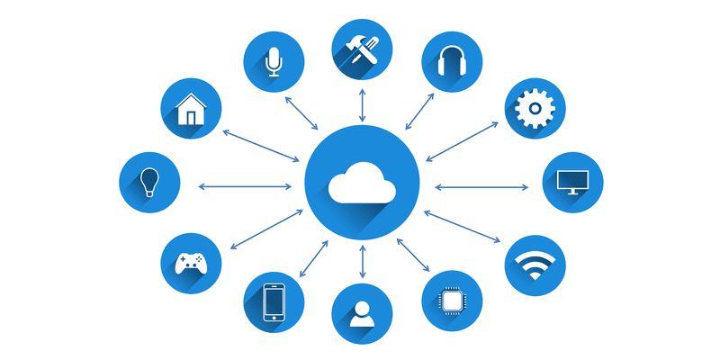
Internet of Things (IoT)
Wireless networks play a crucial role in the IoT ecosystem by connecting a vast array of smart devices and sensors. IoT applications leverage wireless connectivity to enable smart homes, smart cities, industrial automation, healthcare monitoring, and more.

Slide 18
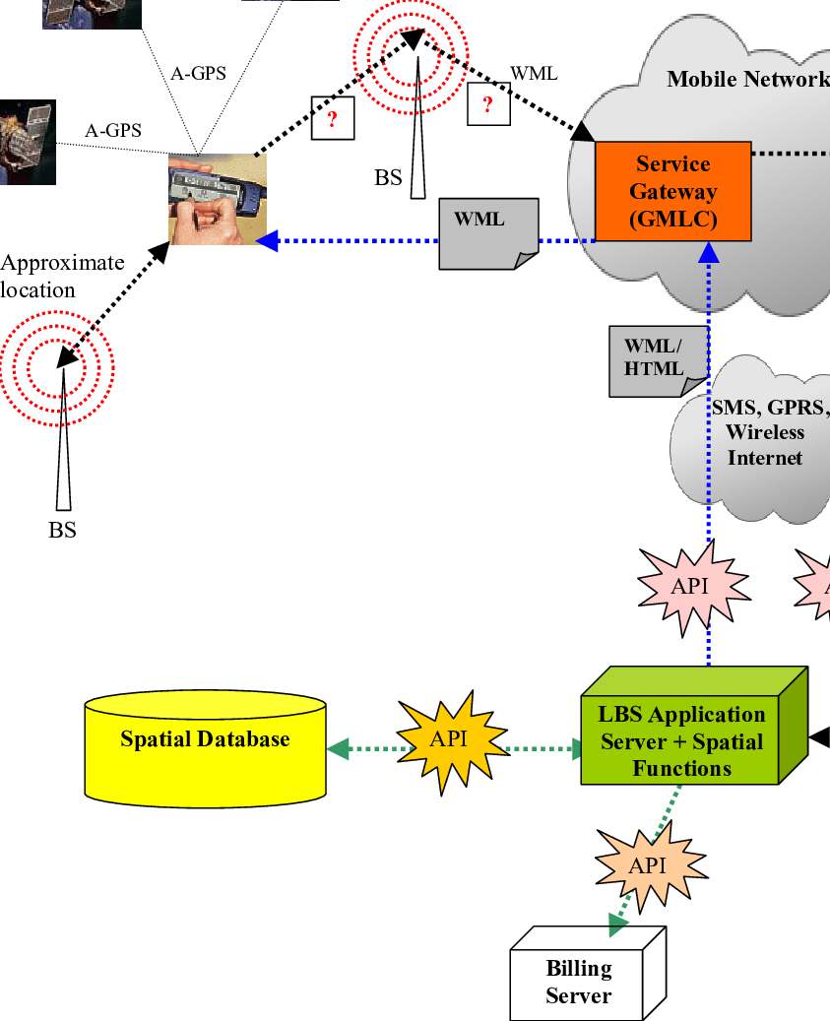
Location-Based Services
Wireless networks enable location-based services such as GPS navigation, asset tracking, and geofencing. These services utilize wireless signals to determine the precise location of devices or objects, enabling tailored experiences and efficient logistics management.

Slide 19
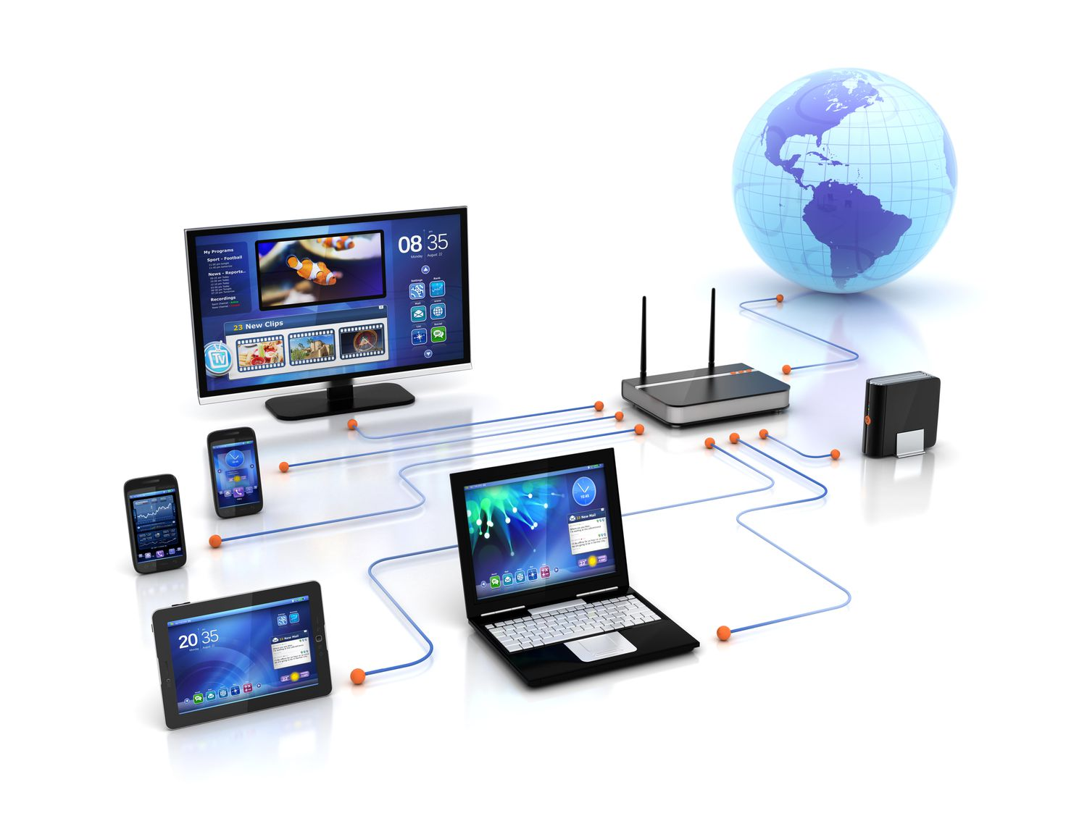
Entertainment and Multimedia
Wireless networks support streaming services, online gaming, and multimedia content delivery to a wide range of devices, including smart TVs, gaming consoles, and streaming media players. This allows users to enjoy entertainment content wirelessly on their preferred devices.

Slide 20
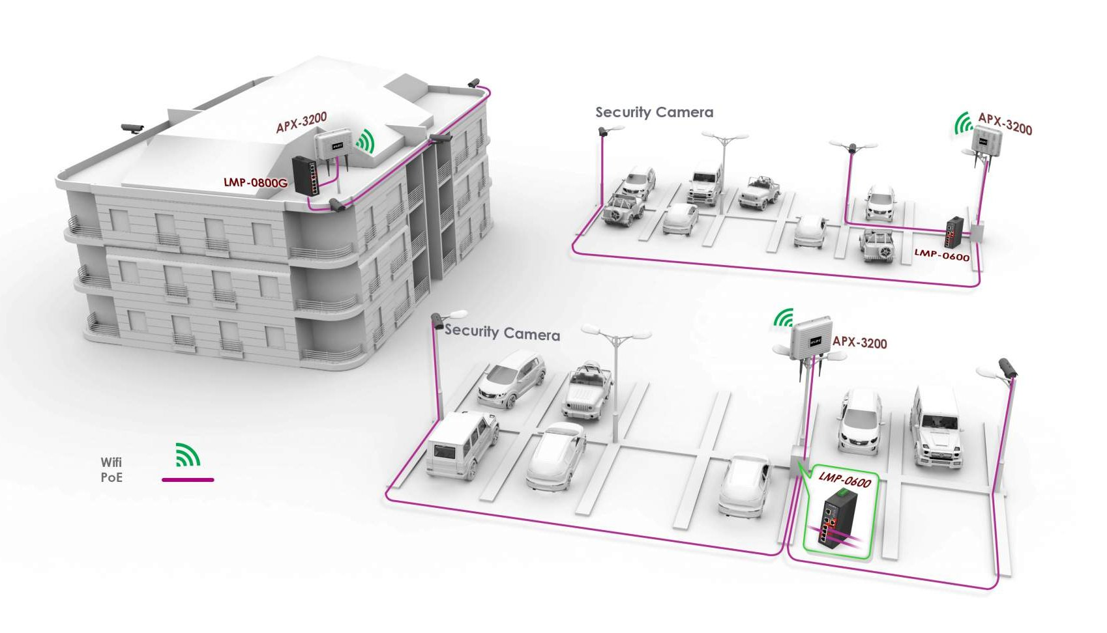
Wireless Surveillance and Security
Wireless networks facilitate the deployment of surveillance cameras, alarm systems, and access control devices for security purposes. These systems enable remote monitoring and management, enhancing security and safety in residential, commercial, and public spaces.

Slide 21
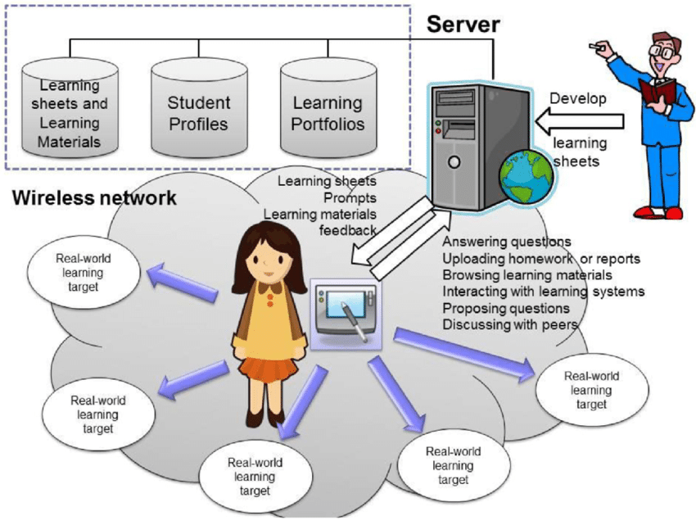
Education and E-Learning
Wireless networks empower educational institutions to deliver digital learning resources, online courses, and collaborative tools to students and educators. This fosters personalized learning experiences, expands access to education, and facilitates remote learning opportunities.

Slide 22
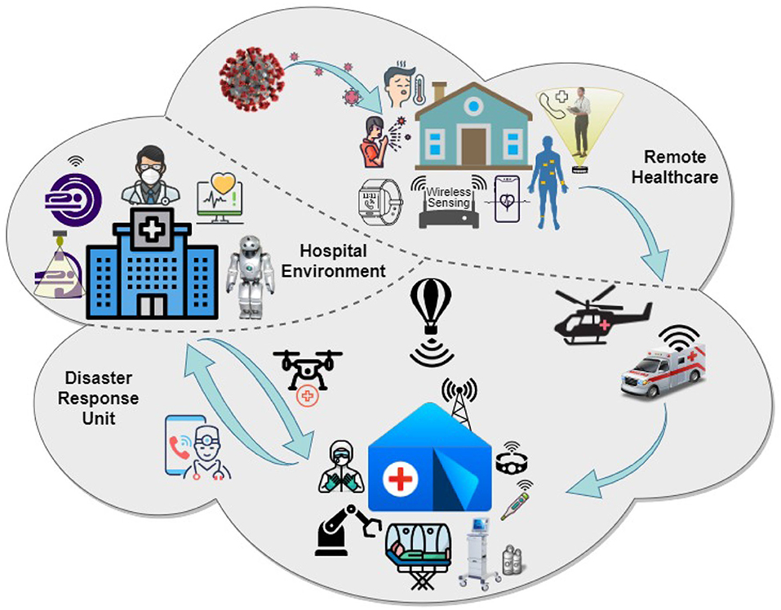
Healthcare and Telemedicine
Wireless networks support telemedicine initiatives by enabling remote patient monitoring, teleconsultation, and telehealth services. Healthcare providers leverage wireless connectivity to deliver medical care and health-related information to patients in real-time.

Slide 23
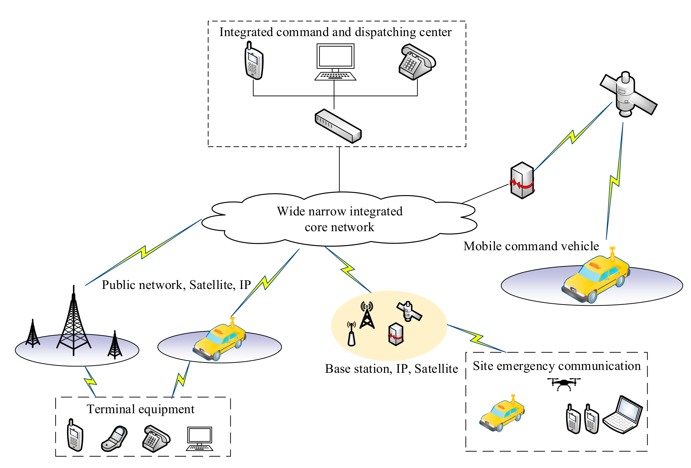
Emergency Communication
Wireless networks play a critical role in emergency communication systems, enabling first responders to coordinate rescue efforts, access vital information, and communicate with command centers during emergencies and natural disasters.

Slide 24
Refrence
https://www.fortinet.com/resources/cyberglossary/wireless-network
https://en.wikipedia.org/wiki/Wireless_network
https://en.wikipedia.org/wiki/Wireless_LAN

Slide 25
Thank You
Thank you for your time and attention.
In summary, we explored Wireless Netwok type and use.

